Slide 1
CIS 4930/6930-002 Data Visualization
MAPS
Paul Rosen
Assistant Professor
University of South Florida
slides credits Miriah Meyer (U of Utah)

Slide 2
Maps!
landmarks
discrete data
continuous data
choropleths
cartograms
projections

Slide 3
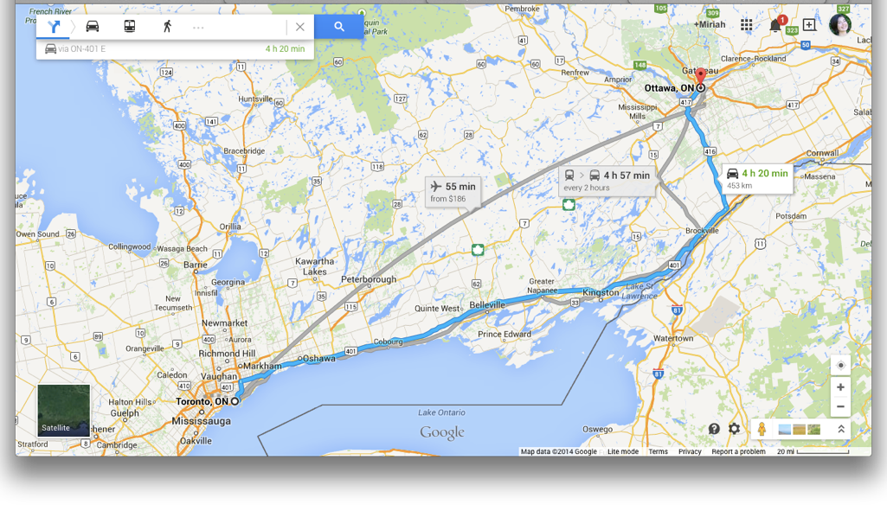
landmarks

Slide 4
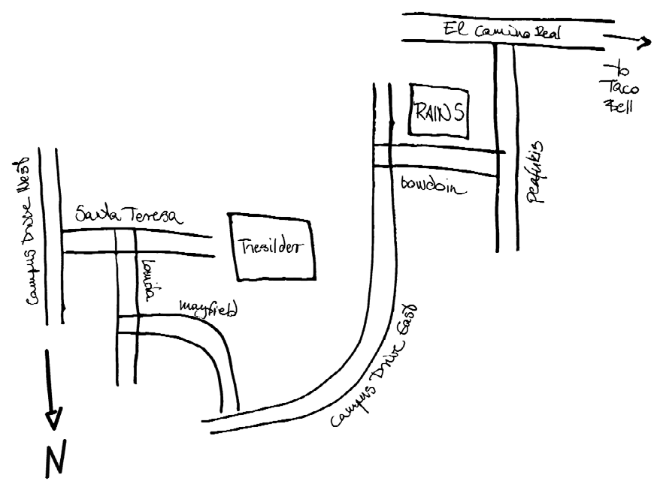
landmarks

Slide 5
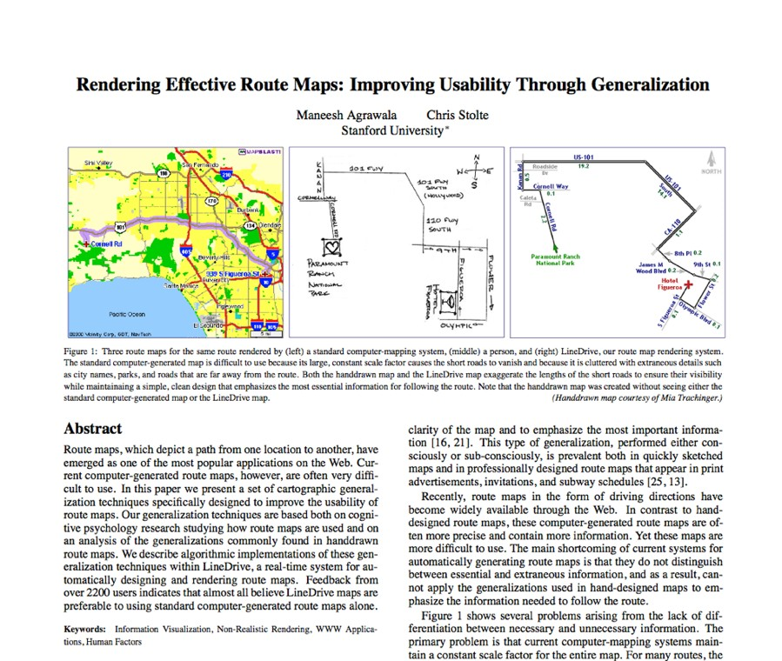
RECOMMENDED READING

Slide 6
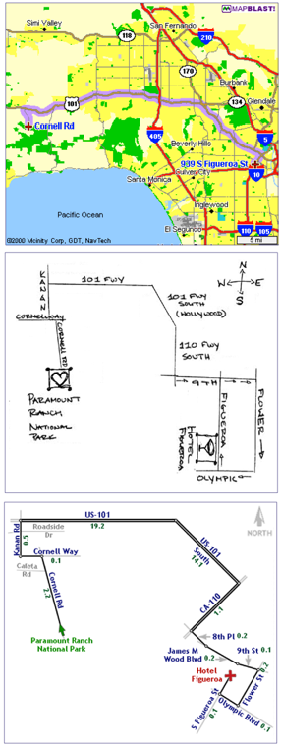
Recommendations
straighten wiggly lines
snap turns to right angles
expand regions with turns
contract long straight roads
label carefully
maintain overall orientation
Agrawala 2001

Slide 7
Discrete data

Slide 8
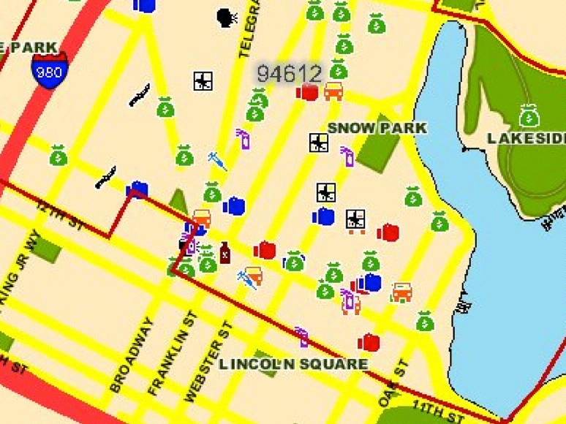
39
Data as icons/glyphs

Slide 9
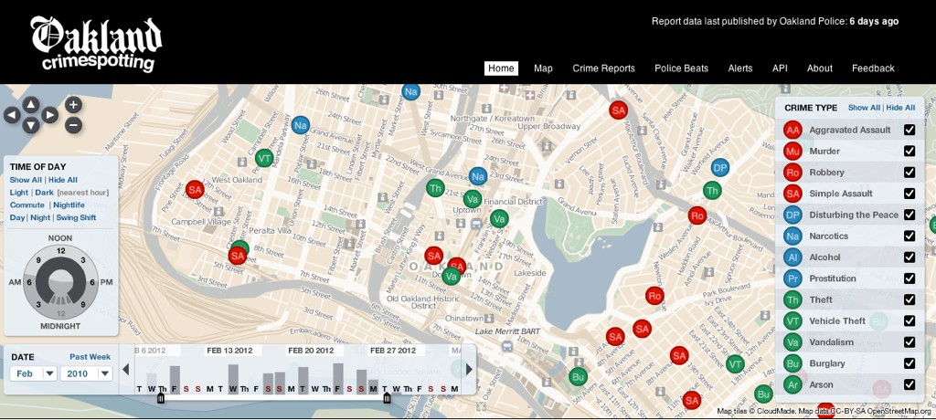
http://oakland.crimespotting.org/

Slide 10
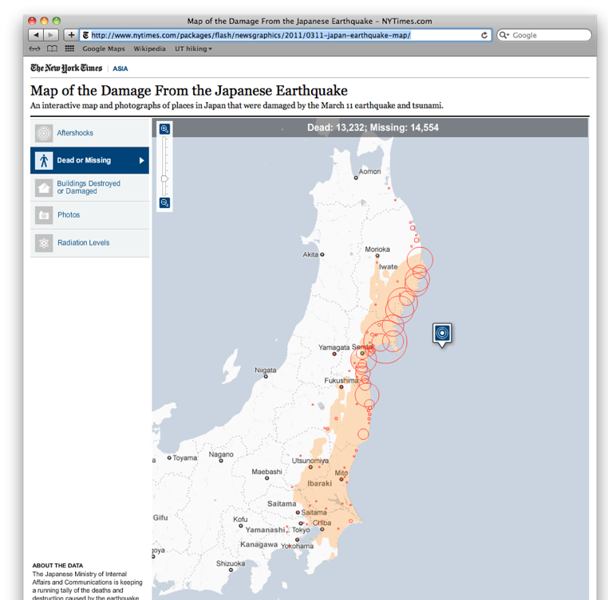
data as points
data : ordered/ quantitative
encoding : size
42

Slide 11

traffic

Slide 12
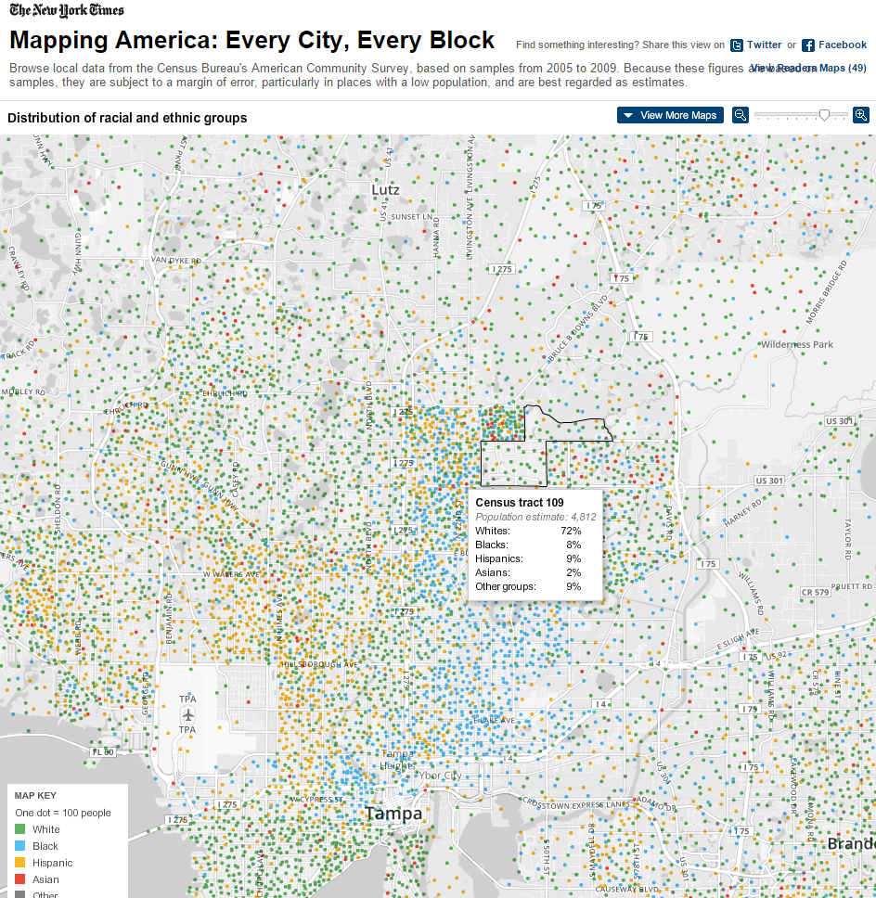
data as points
data : categorical
encoding : hue
http://projects.nytimes.com/census/2010/explorer

Slide 13
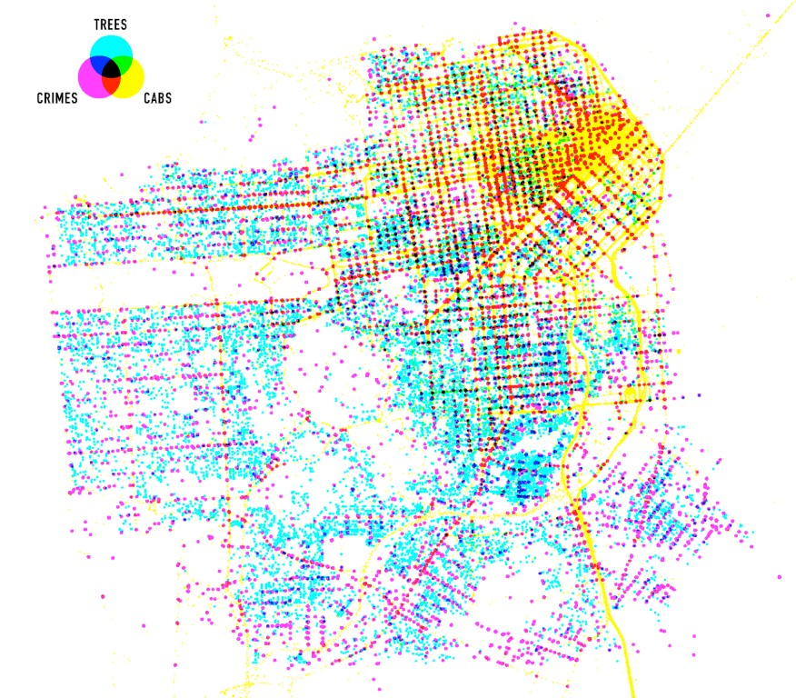
data as points
data : categorical
encoding : hue
http://www.flickr.com/photos/shazbot/3282821808/in/set-72157614736071588/

Slide 14
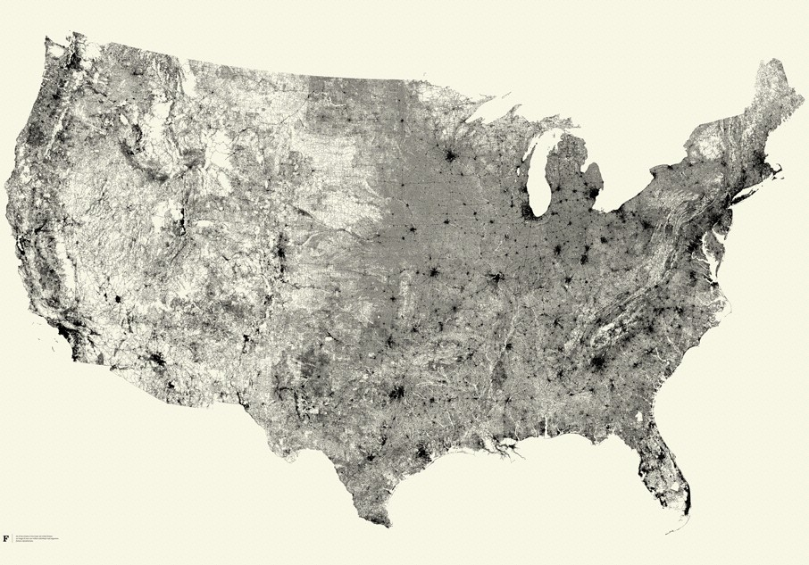
data as lines
47
http://fathom.info/allstreets/

Slide 15
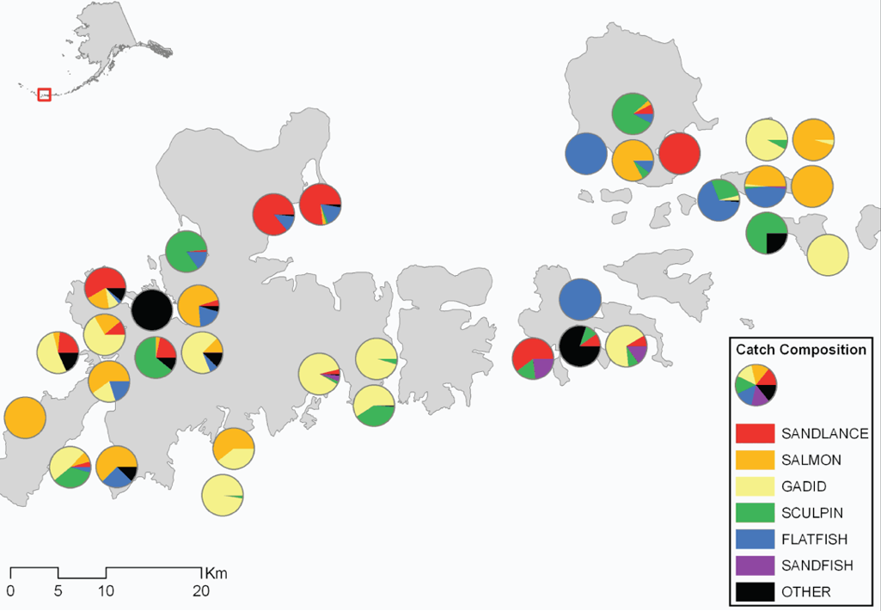
data as charts
http://alaska.usgs.gov/science/biology/seabirds_foragefish/foragefish/Aleutian/results.php

Slide 16
continuous data

Slide 17
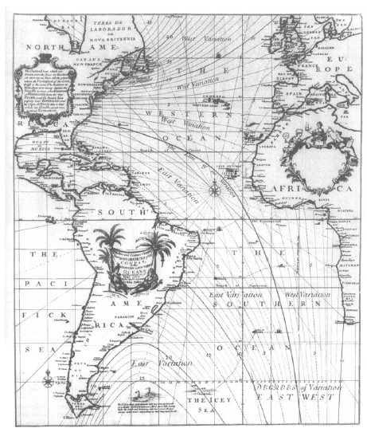
Lines of Equal Magnetic Declination
first contour map
isopleth
map which overlays continuous data using a third encoding channel
Edmond Halley, 1701

Slide 18
HEATMAPS

Slide 19
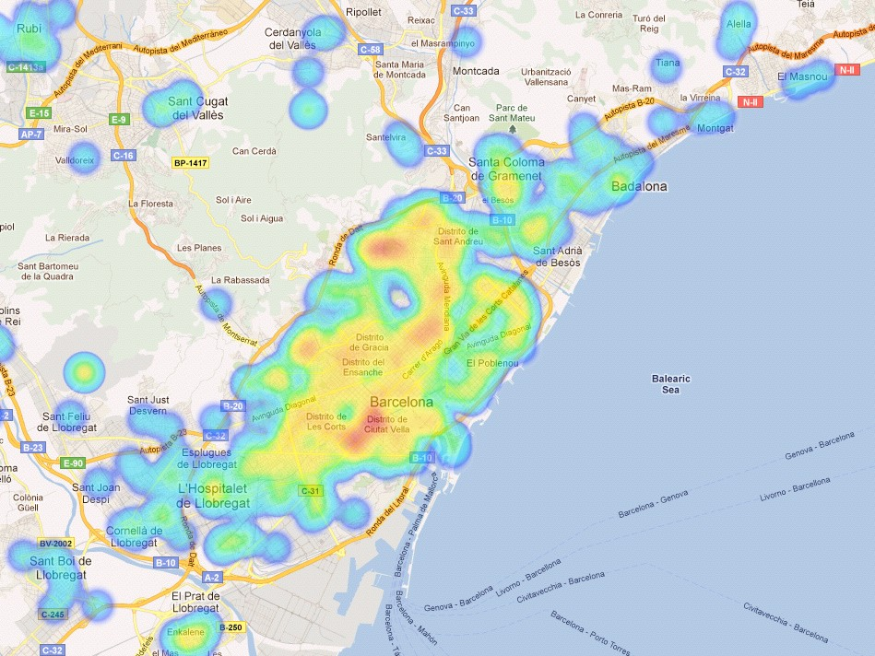
52
Heatmap
http://es.deister.net/es/solutions/ax-mobile/ax-mobile-components-maps/

Slide 20
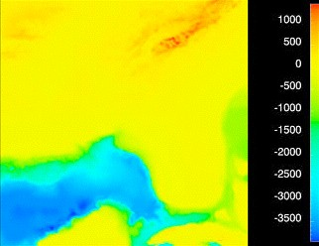
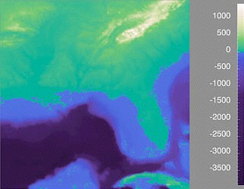
choose the appropriate colormap

Slide 21
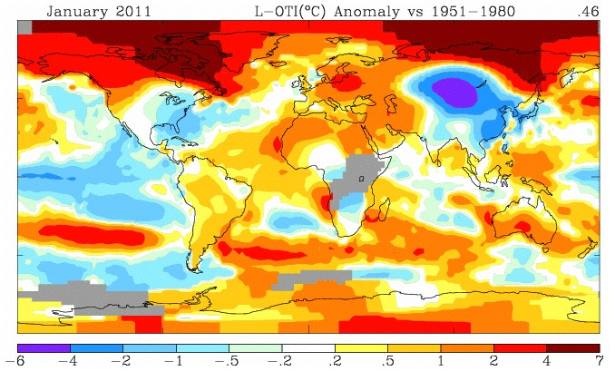
bin the data

Slide 22
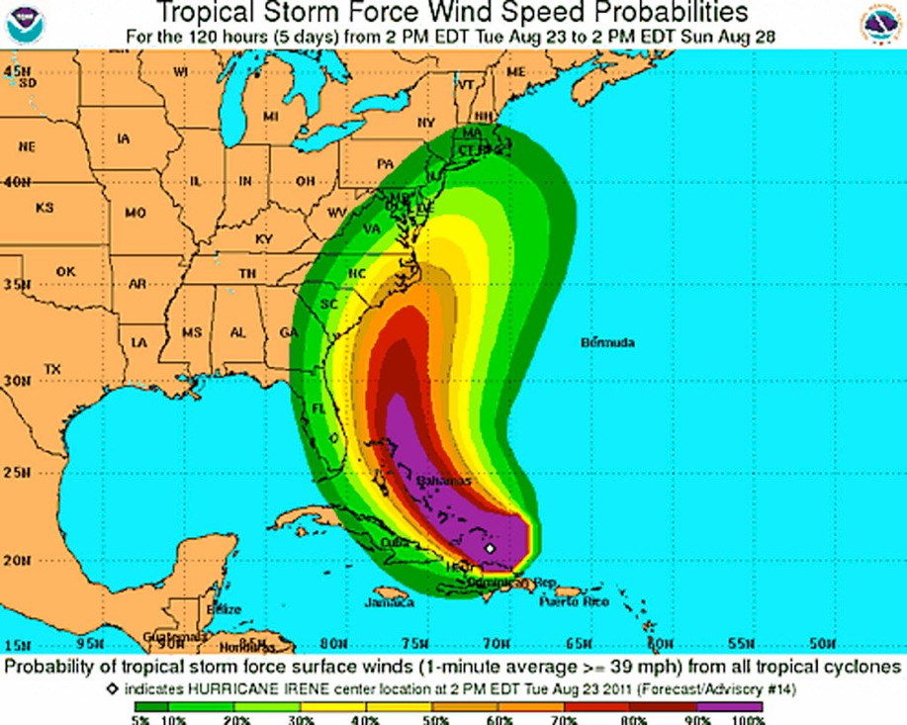
http://www.nola.com/hurricane/index.ssf/2011/08/hurricane_irene_lashes_the_tur.html

Slide 23
ISOCURVES

Slide 24
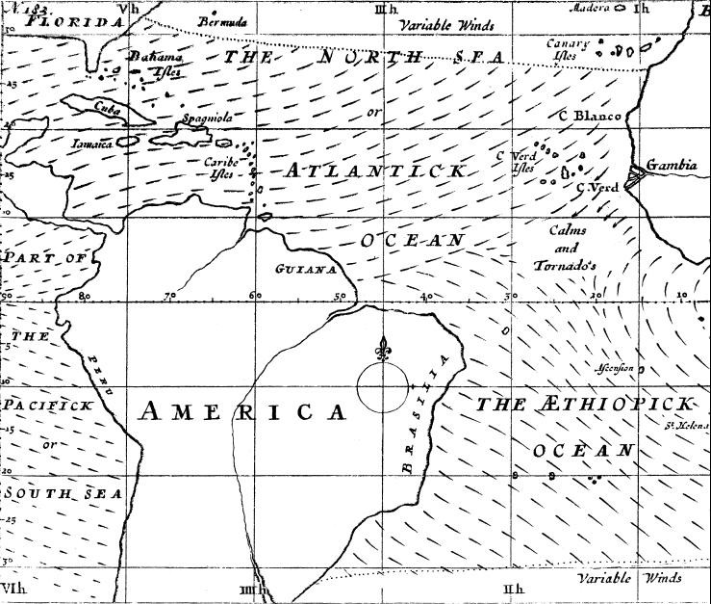
Wind Map
first weather map
Edmond Halley, 1686

Slide 25
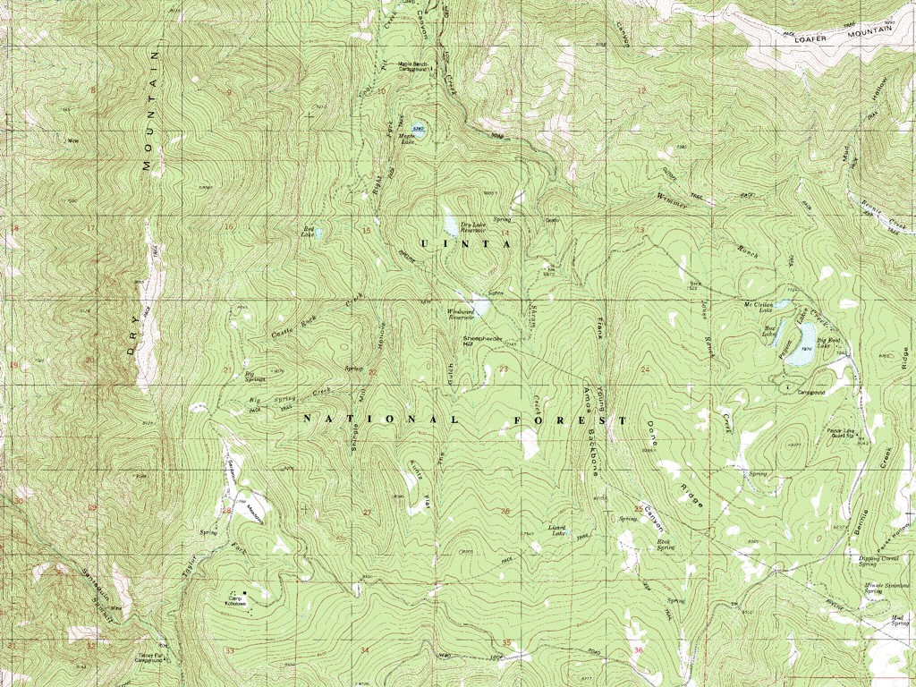
58
show topology
http://wikimapia.org/3856233/Tinney-Flat-Campground

Slide 26
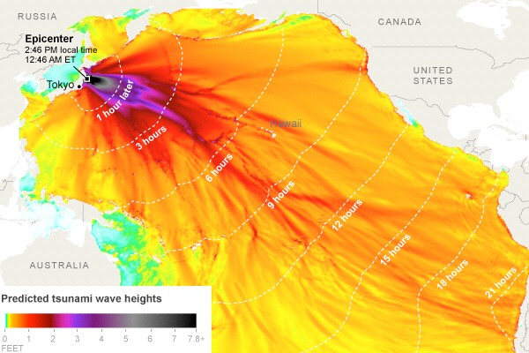
show time
http://www.nytimes.com/interactive/2011/03/11/world/asia/maps-of-earthquake-and-tsunami-damage-in-japan.html

Slide 27
choropleths

Slide 28
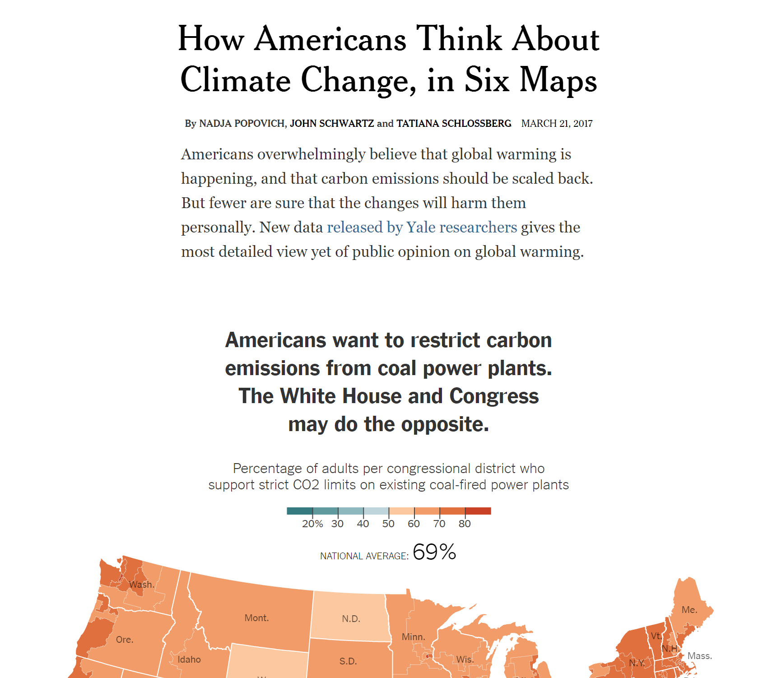
https://www.nytimes.com/interactive/2017/03/21/climate/how-americans-think-about-climate-change-in-six-maps.html?_r=0

Slide 29
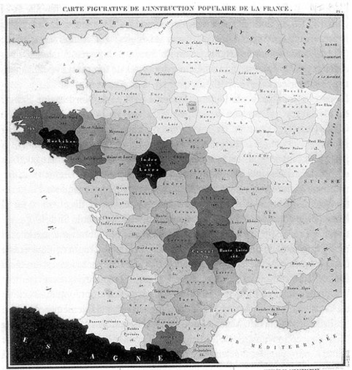
Illiteracy in France
first choropleth map
choropleth
map in which areas are shaded, colored, or patterned relative to a data attribute value
Charles Dupin, 1826

Slide 30
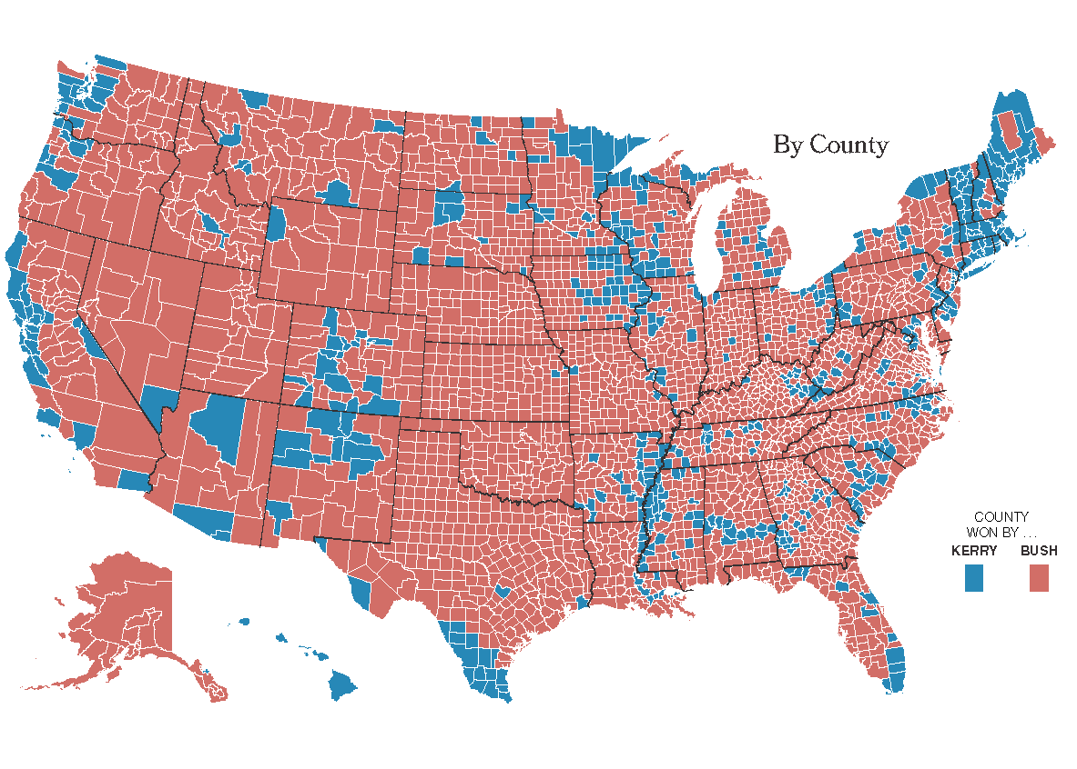
Kerry vs Bush, 2004
Matthew Ericson, NY Times

Slide 31
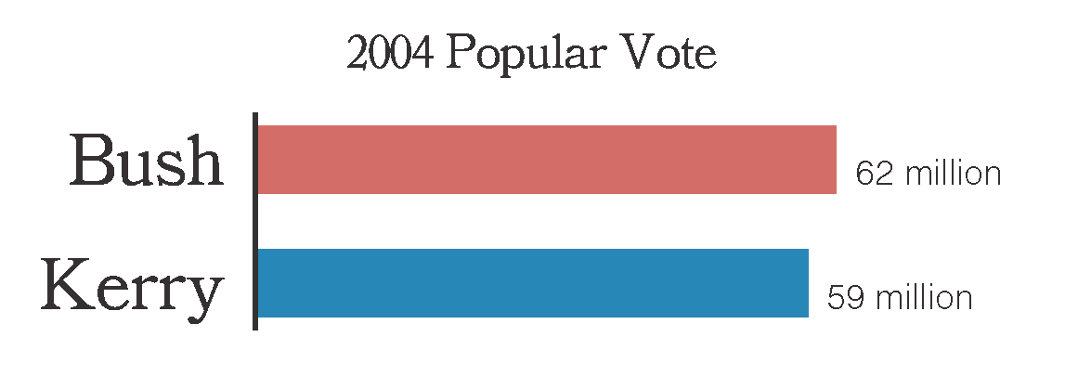
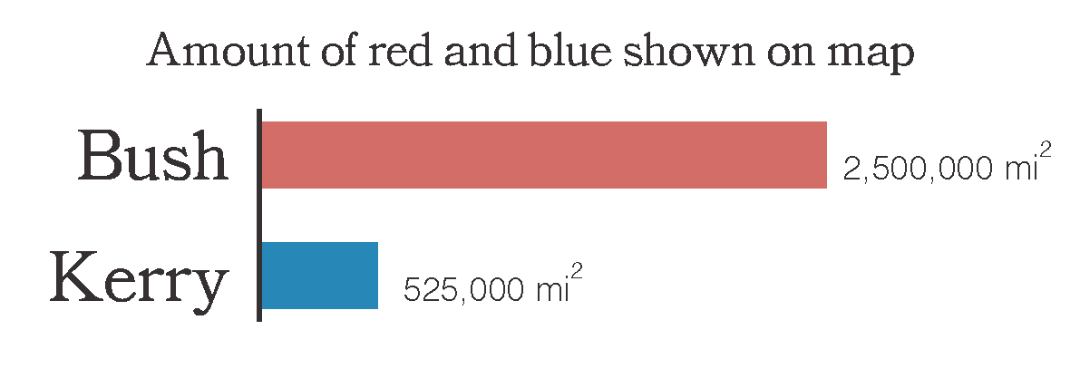
Matthew Ericson, NY Times

Slide 32
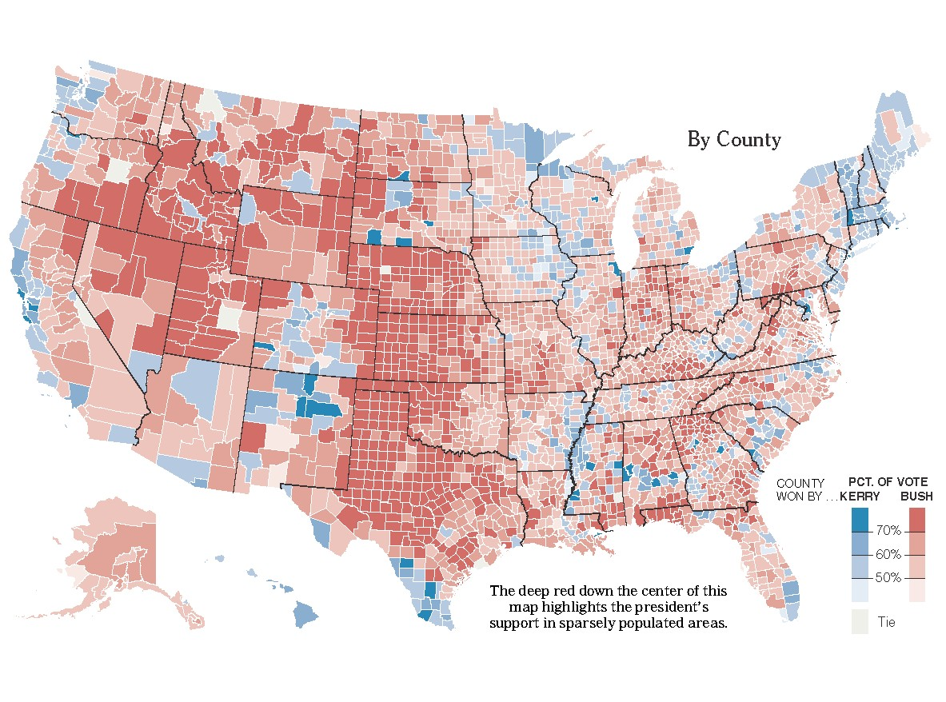
Matthew Ericson, NY Times

Slide 33
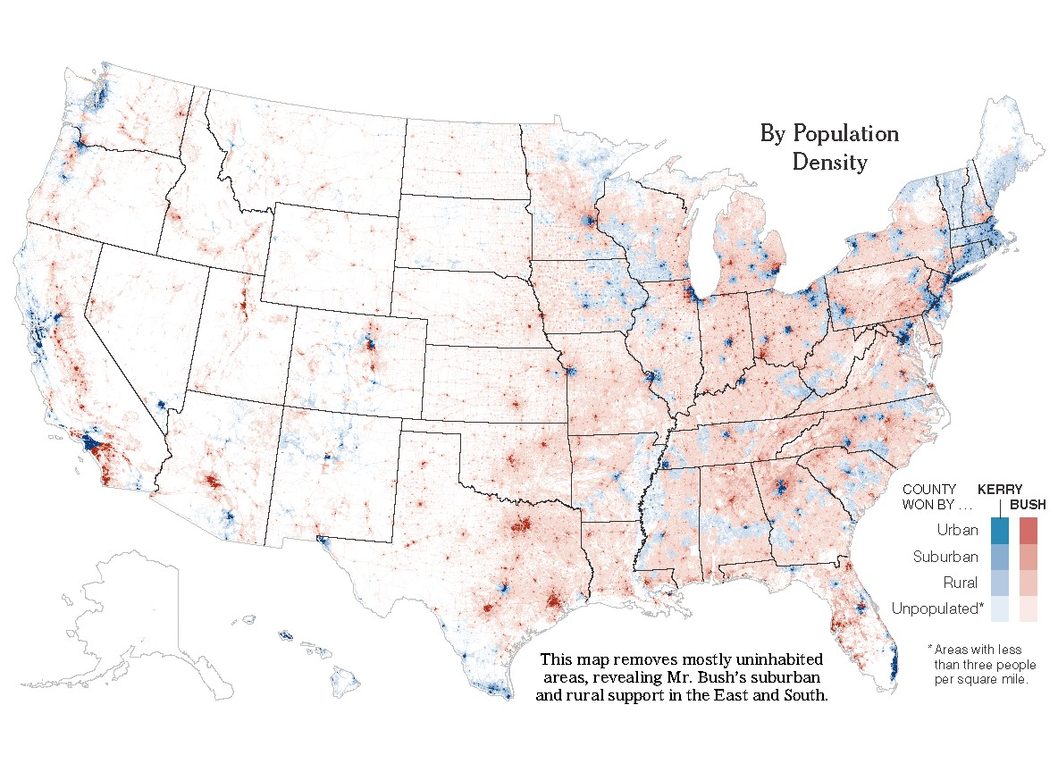
Matthew Ericson, NY Times

Slide 34
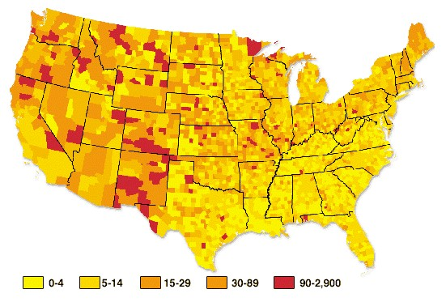
UFO hotspots
http://www.ufoera.com/images/ufo/ufo-hotspots-map_117.png

Slide 35
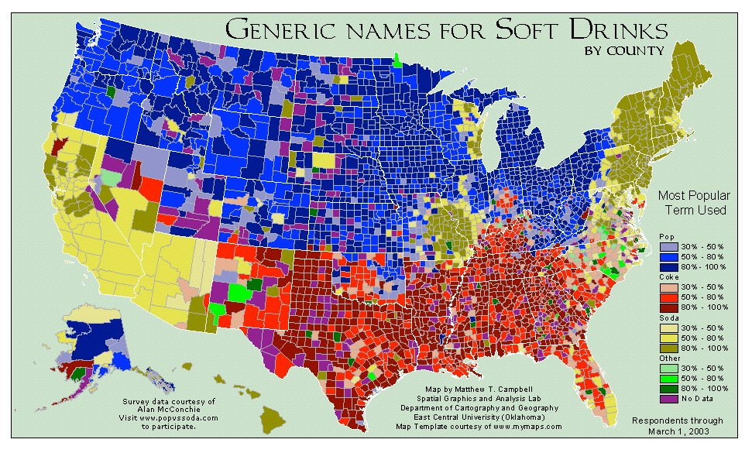
http://popvssoda.com/

Slide 36
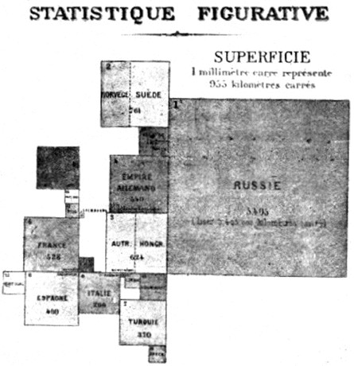
cartogram
map in which areas are scaled and distorted relative to a data attribute value
Land Area
first cartogram
Emile Levasseur, 1868

Slide 37
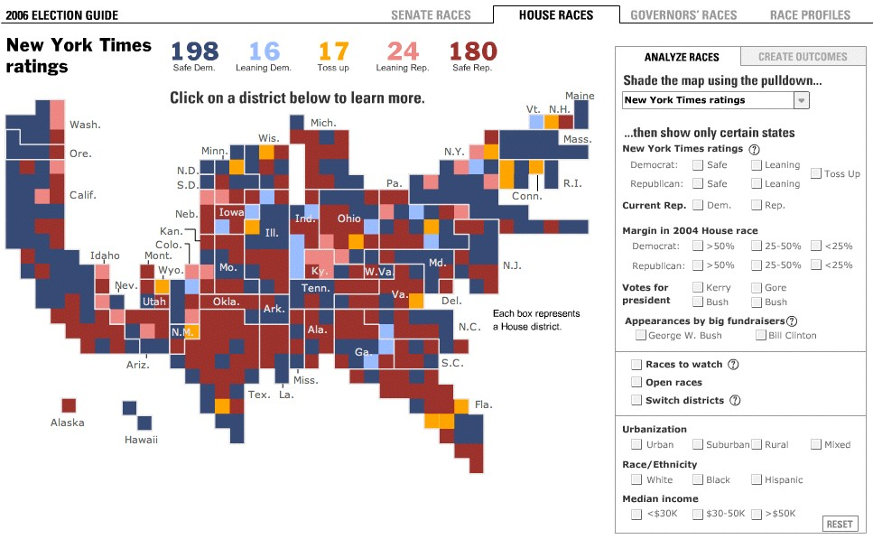
rectangular cartogram
http://www.nytimes.com/ref/washington/2006ELECTIONGUIDE.html

Slide 38
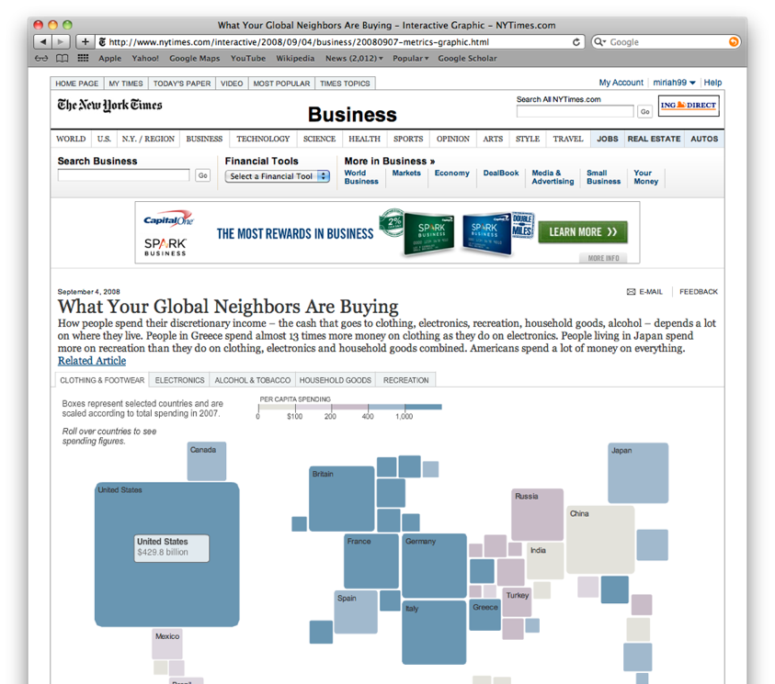
http://www.nytimes.com/interactive/2008/09/04/business/20080907-metrics-graphic.html?_r=0
73

Slide 39
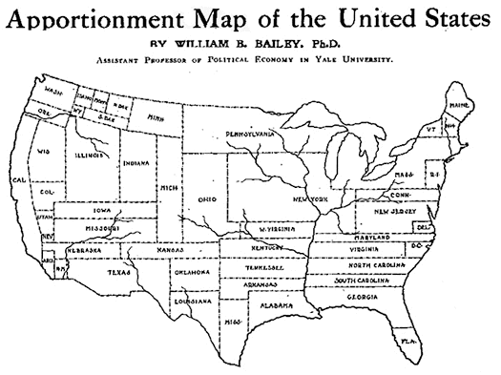
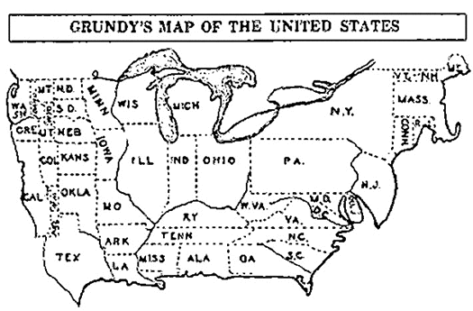
Population
first nonrectangular cartogram
Population and Federal Taxes
first modern cartogram
William Bailey, 1910
Joseph Grundy, 1929

Slide 40
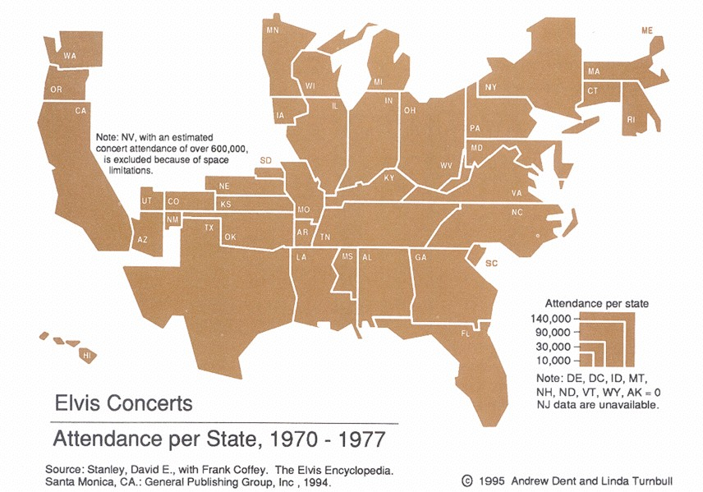
area scaled by data

Slide 41
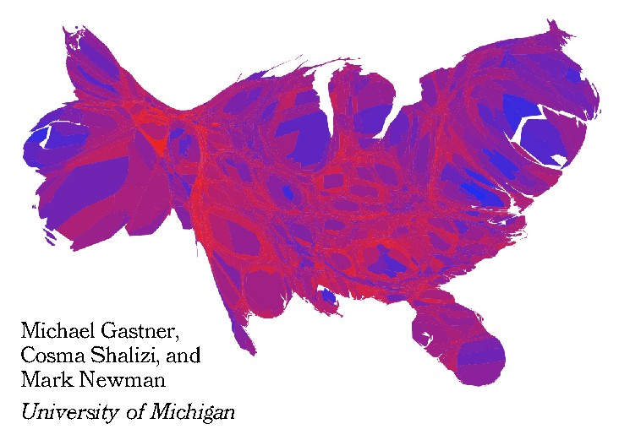
Kerry vs. Bush, 2004
distortion via diffusion
Matthew Ericson, NY Times

Slide 42
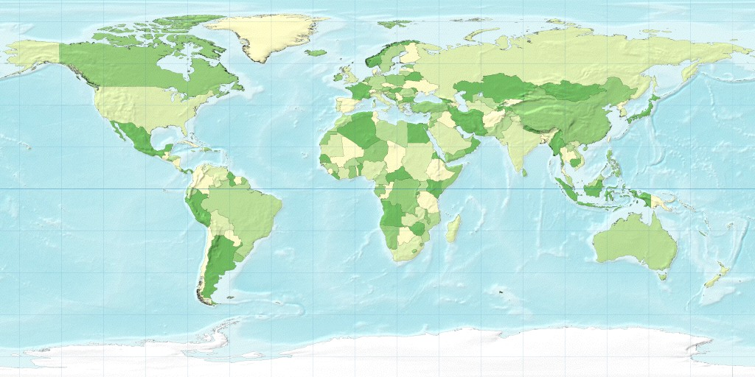
the world
http://www-personal.umich.edu/~mejn/cartograms/

Slide 43
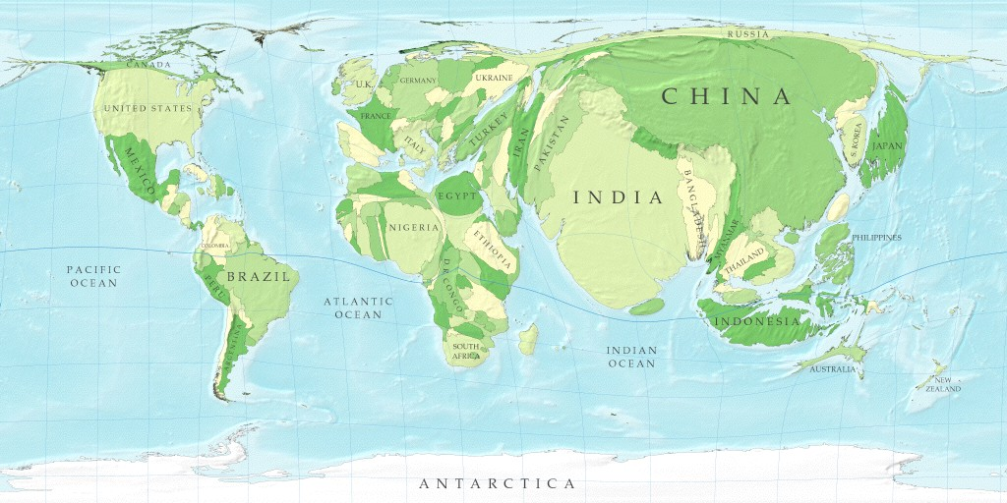
population
http://www-personal.umich.edu/~mejn/cartograms/

Slide 44
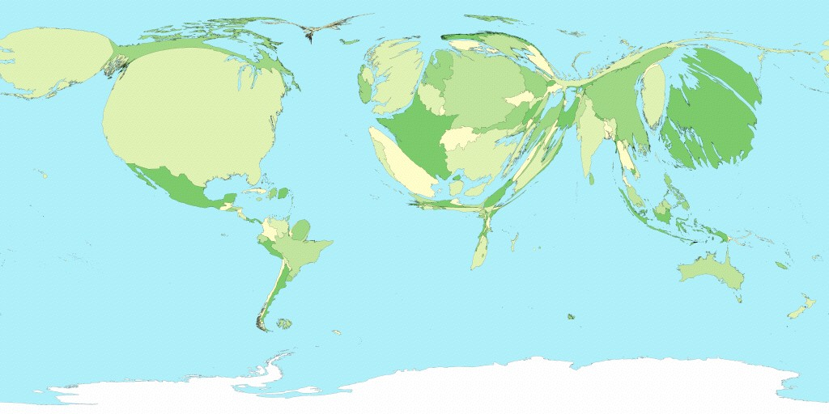
GDP
http://www-personal.umich.edu/~mejn/cartograms/

Slide 45
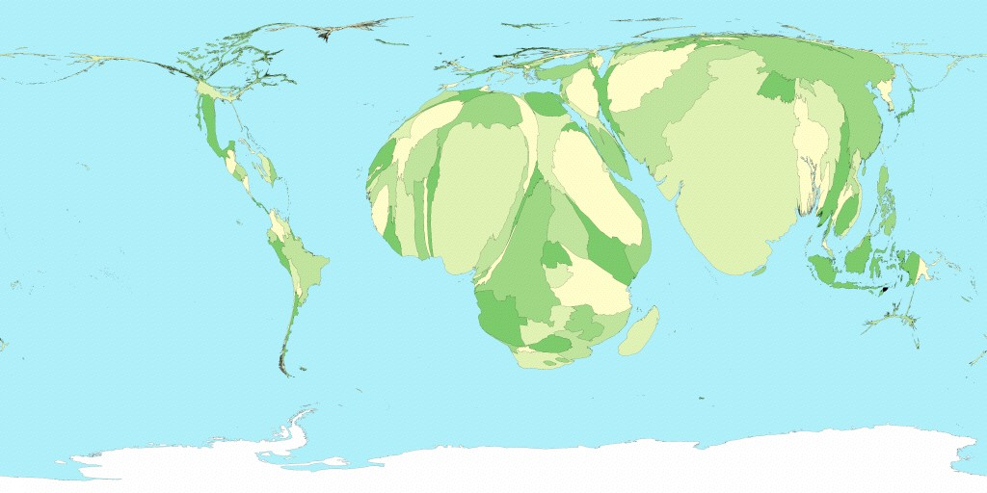
child mortality
http://www-personal.umich.edu/~mejn/cartograms/

Slide 46
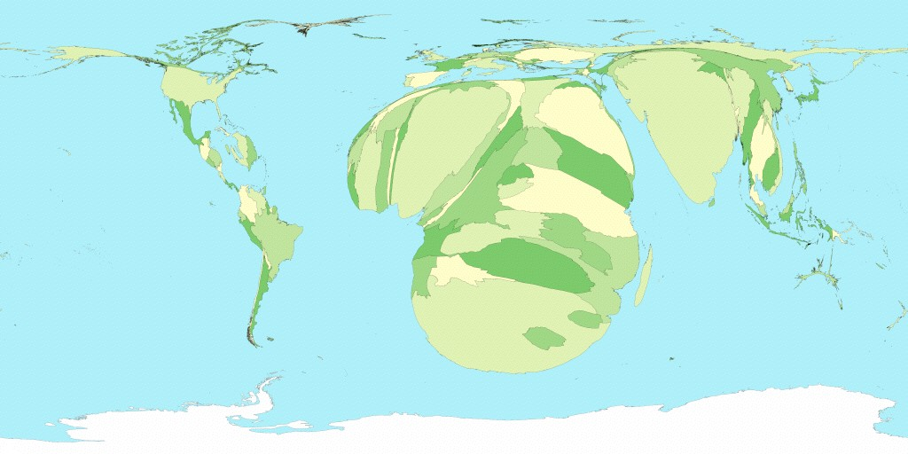
people living with HIV/AIDS
http://www-personal.umich.edu/~mejn/cartograms/

Slide 47
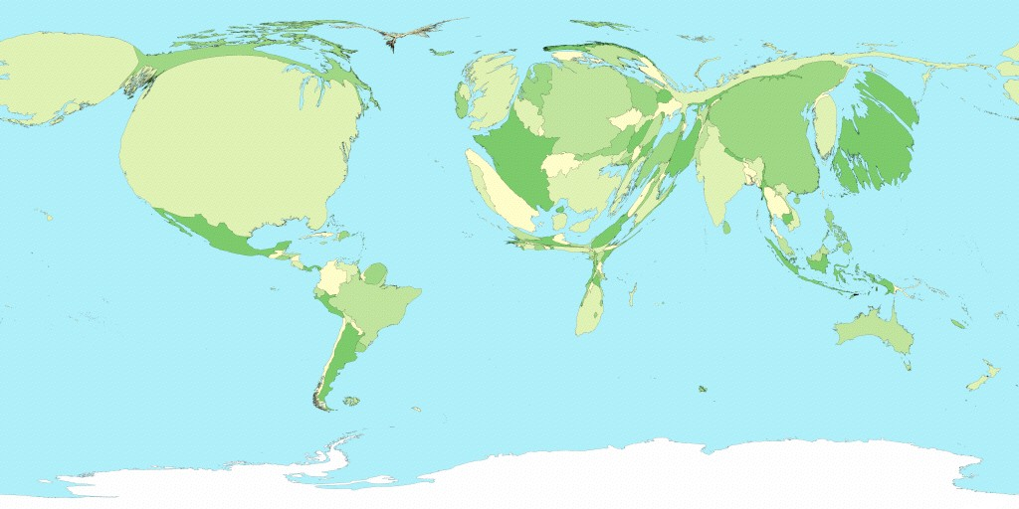
total spending on healthcare
http://www-personal.umich.edu/~mejn/cartograms/

Slide 48
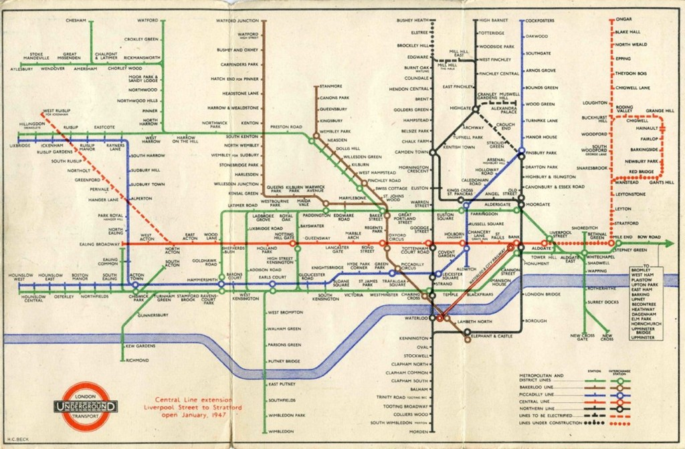
Harry Beck’s Tube Map

Slide 49

do they work?
85

Slide 50
Projections
flattening the globe

Slide 51
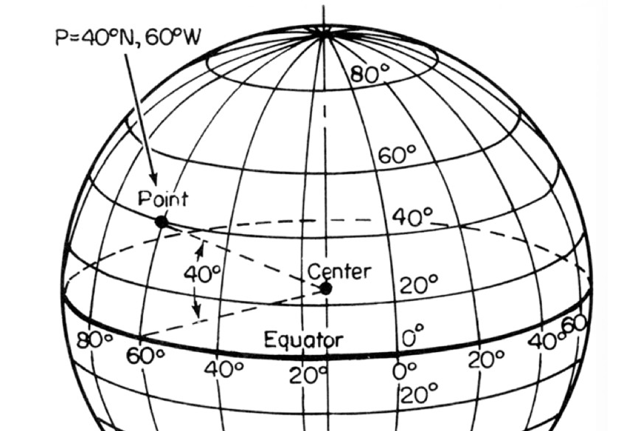
latitude, longitude

Slide 52
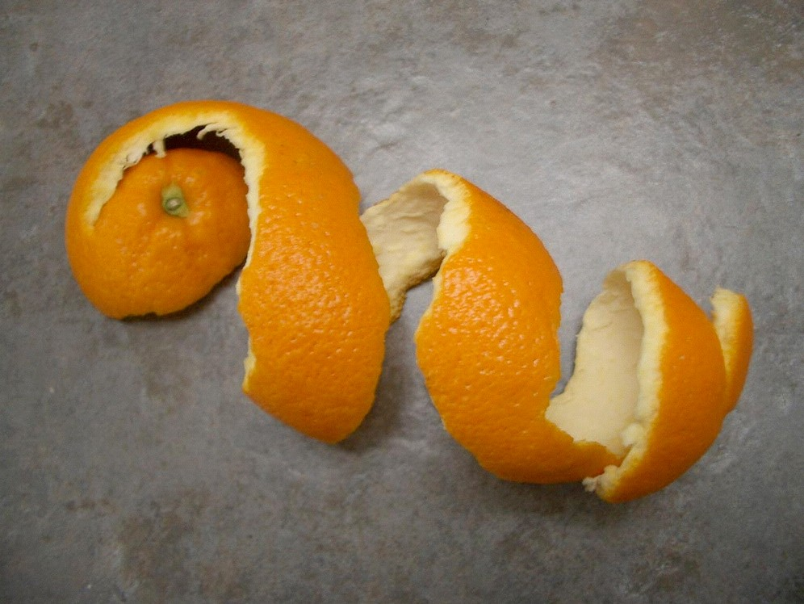
89
a sphere tears when you flatten it
http://www.oocities.org/suzy_gillece/

Slide 53
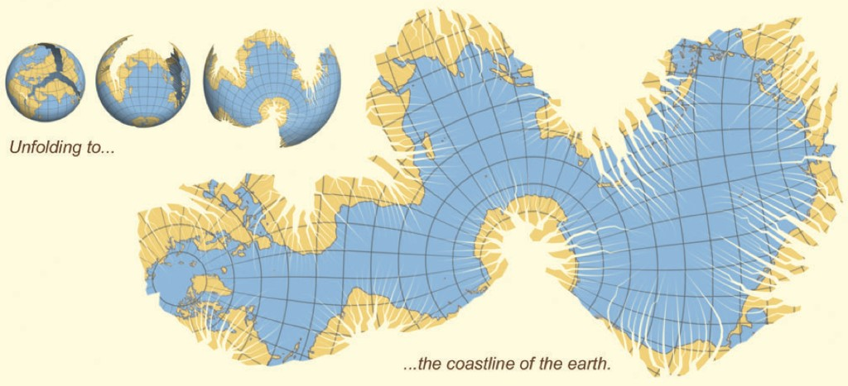
many ways to tear...
16
myiahedral projection
Wijk 2008
90

Slide 54
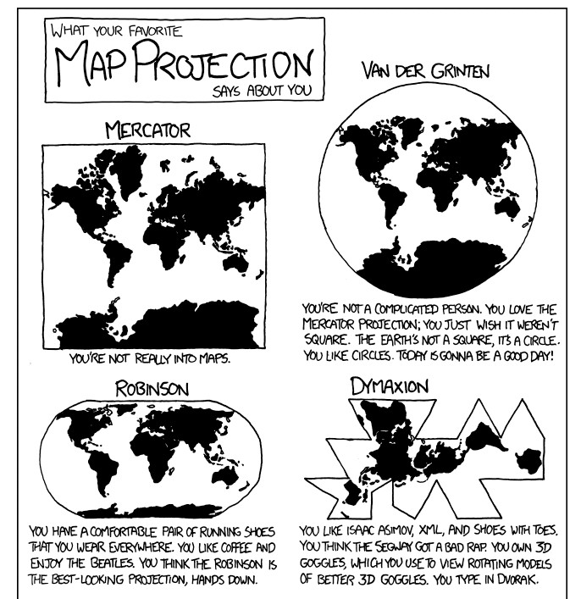

Slide 55
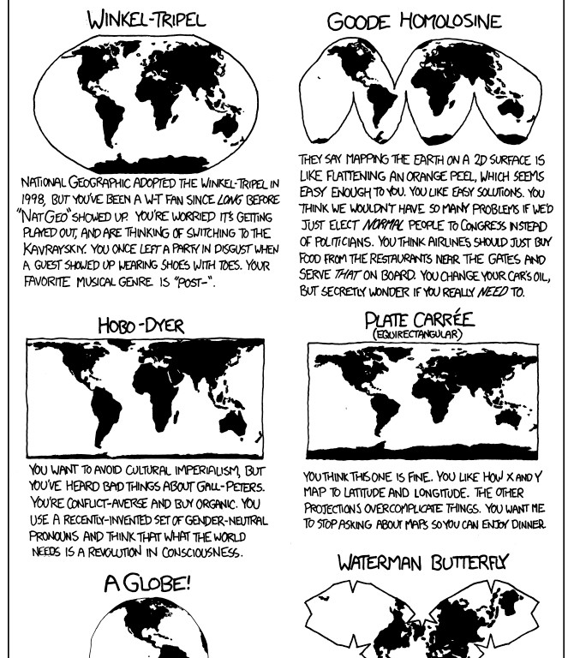

Slide 56
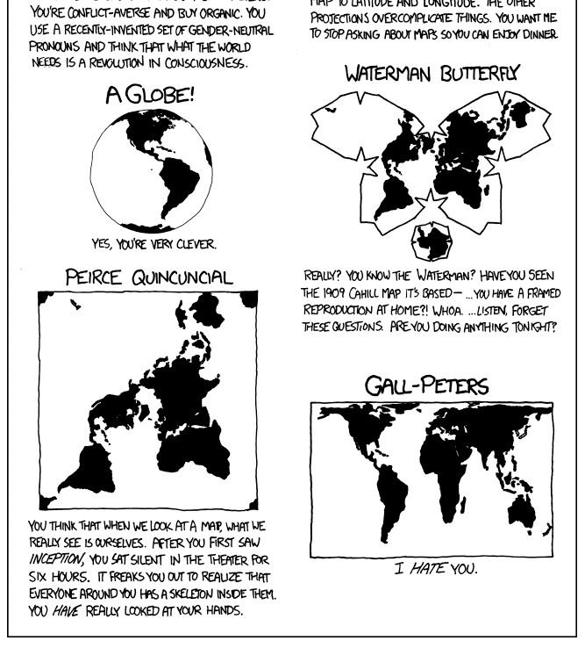
http://xkcd.com/977/

Slide 57
CLASSES OF PROJECTION
What map features would you like to maintain?

Slide 58
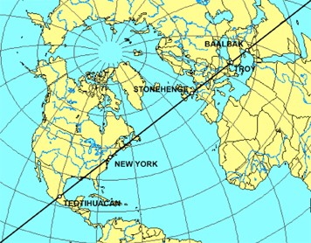


azimuthal
preserves direction
equal-area
preserves area
conformal
preserves local shapes

